Slide 1
Lunchroom Changes
We will be making changes to help reduce waste at lunch.
Watch the video on the next slide to learn more about why this is important!

Slide 3
Starting January 29th
We will have
A bucket for emptying liquids like milk or juice
Recycling bins for milk cartons and cardboard
Compost bins for food scraps
New signs for the bins
New dismissal routines
Student Helpers and Parent Volunteers to guide you!

Slide 4
New: Signs for Bins
You will see 4 new signs in the lunchroom.
View the next 4 slides for a sneak peek!

Slide 5
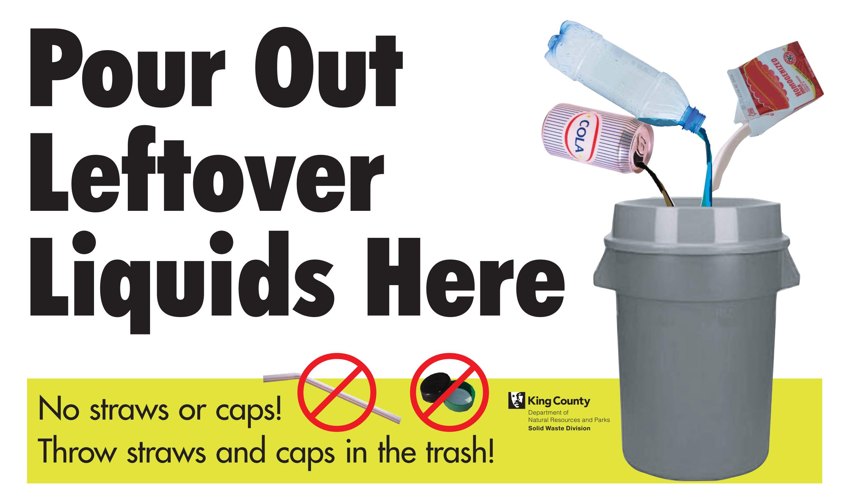

Slide 9
New: Lunch Dismissal Routine
When dismissed, you will have a new routine of where to go.
Look at the next slides for more details.

Slide 10
Lunchroom Layout with Composting
Pizza
Garden Bar
Cashier
Condiments
Entrees
Milk Bucket
R
R
Juice
T
T
Milk
C
C
Lunch Cards
Trays
Lunch Pouches
When dismissed, you will follow the green arrows.
Lunch Line

Slide 11
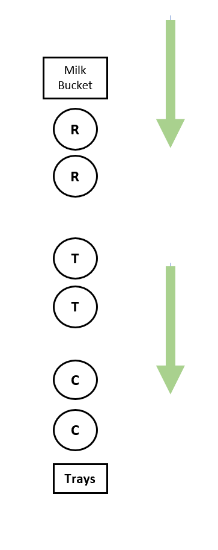
START HERE
Empty Liquids
Recycle Containers
Throw away trash in garbage can
Add compostable items to compost bin
Stack trays to compost
END HERE

Slide 12
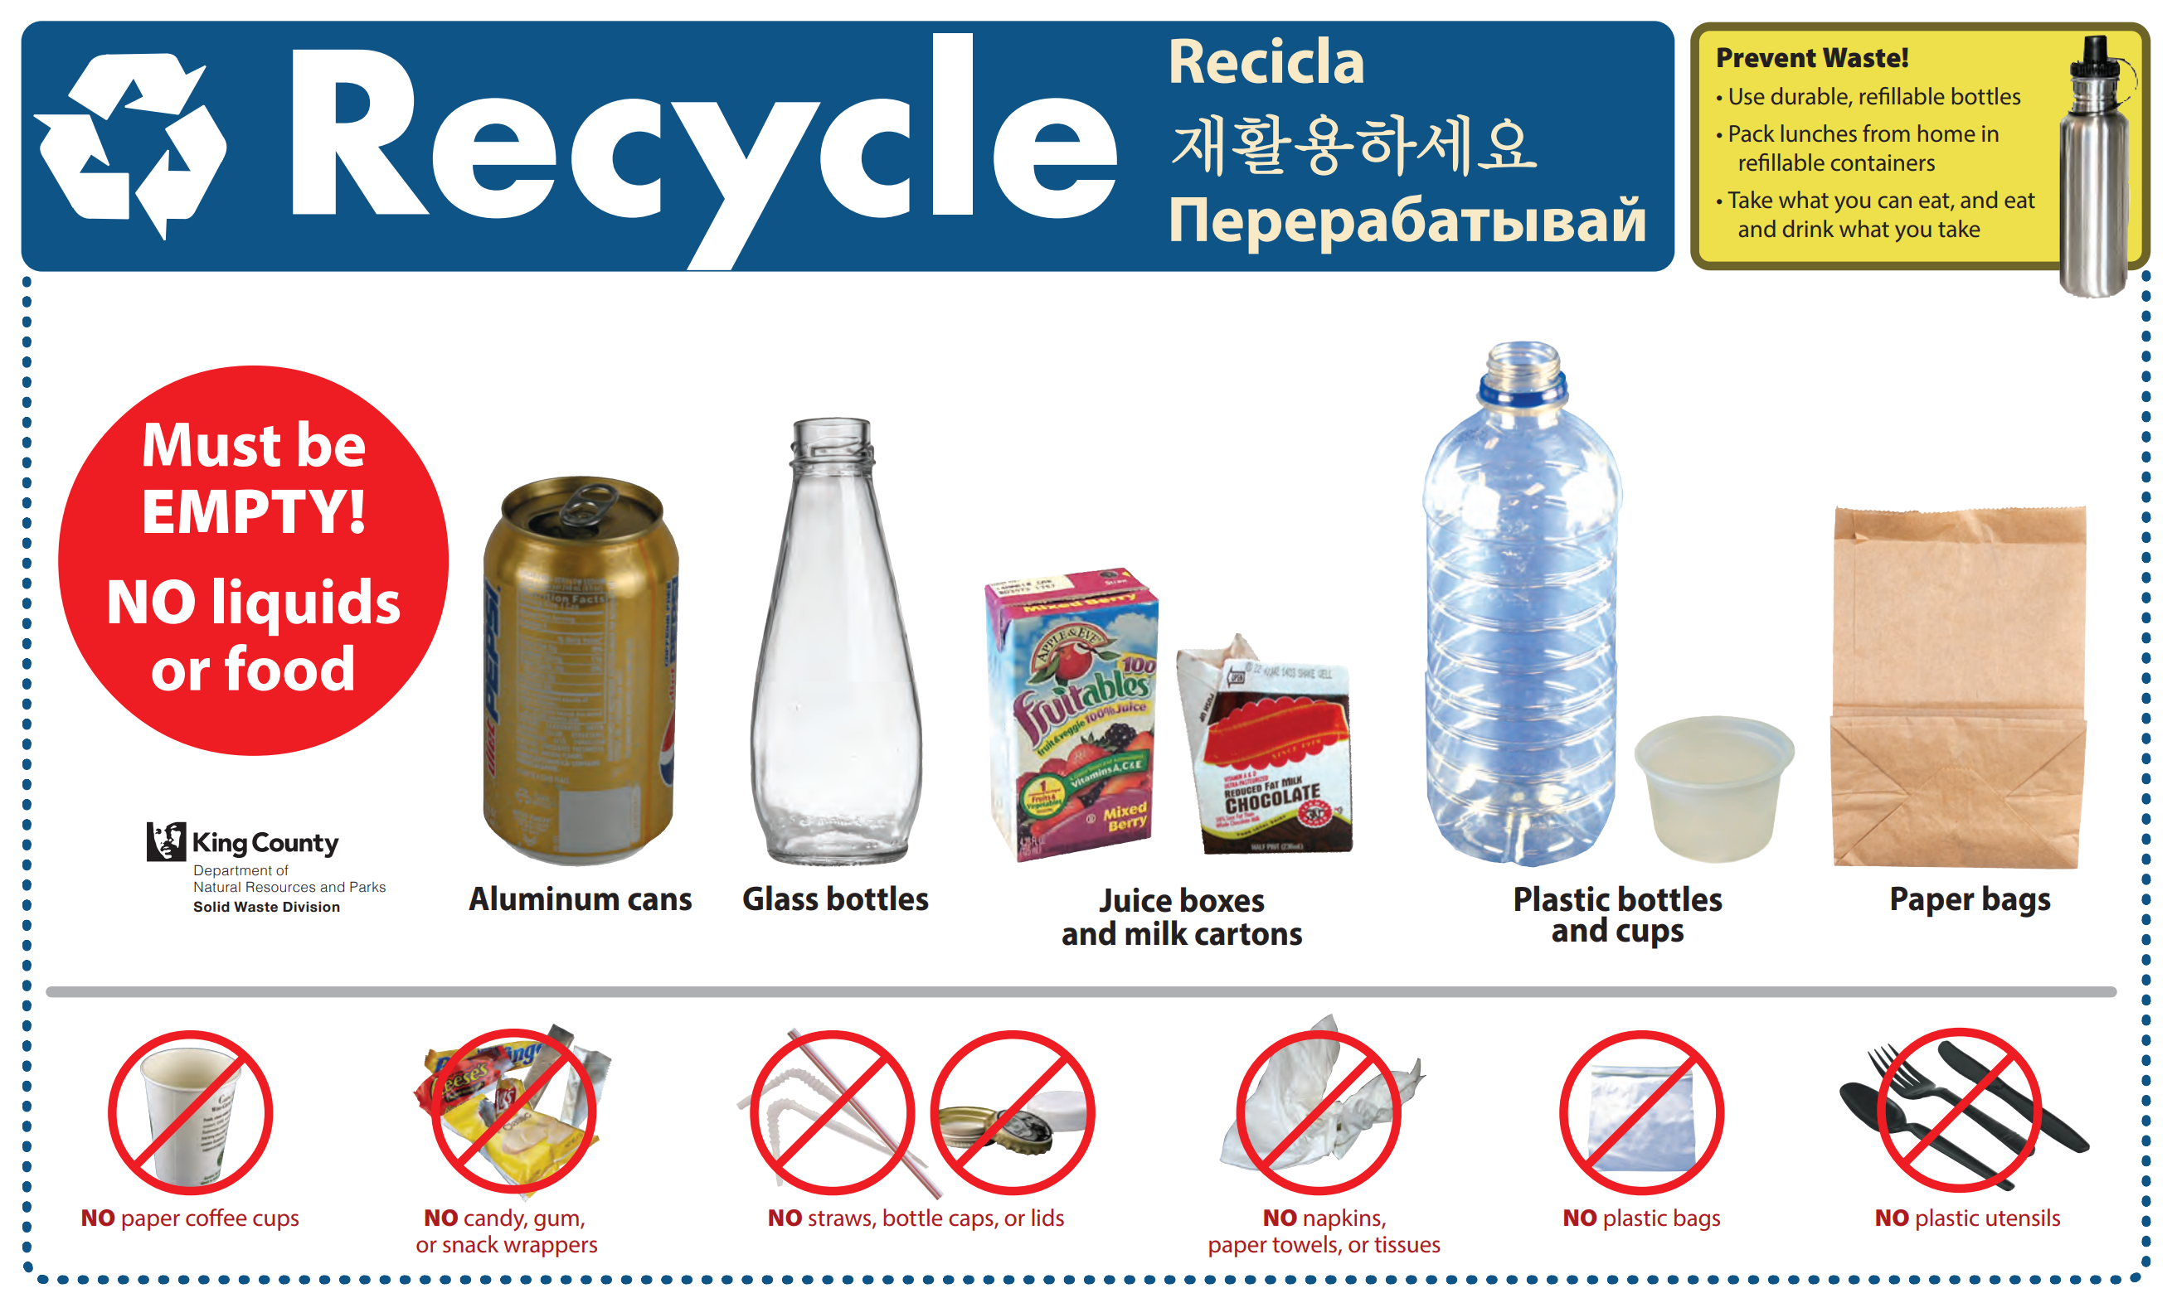
STACK TRAYS

Slide 13
Thank you, Dolphins!
Together we can help reduce waste at Smith!

Slide 14
Ways to Reduce Waste at Lunch
Only take what you’ll eat
Think before throwing away food
Save food for later when possible
If you bring lunch, bring your food in reusable containers
Do you always have leftovers? Think about what you could take less of, while still filling your tummy! Talk with your family.

Slide 15
Fast Facts
Trash that sits at the landfill and slowly decomposes is a source of greenhouse gases. Recycling and composting reduces the amount of materials that are sent to the landfill. (www.wastefreelunches.org)
In King County, food scraps make up 32% of school garbage. (KCGS Program)
Food scraps and food-soiled paper can be turned into compost, which helps build healthy soil in yards and gardens. (KCSW Division)

Slide 16
More information for 3-5 only

