Slide 1
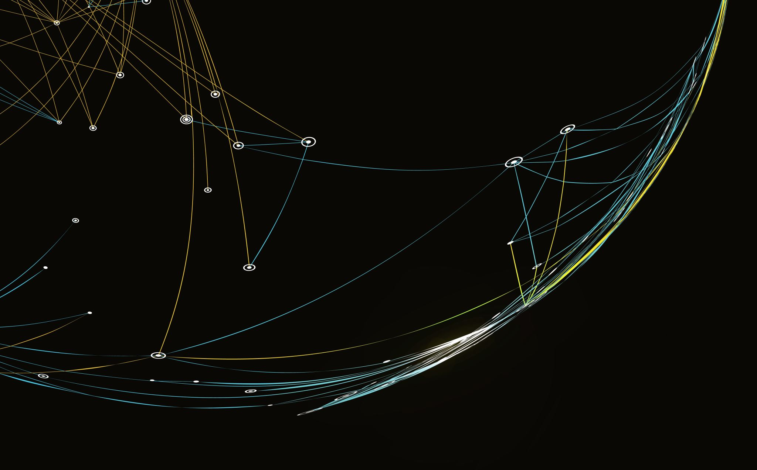
Samantha Smith Elementary Science Olympiad Information Session

Slide 2
Introduction
Janaki Venkatesh – Senior @ Eastlake High School
6 years in Science Olympiad
10x regional medalist, 6x state medalist, 1x national medalist
Science Olympiad state board
President of Eastlake Science Olympiad Team

Slide 3
What is Science Olympiad?
Science Olympiad is the premier team STEM competition in the nation, providing standards-based challenges.
Kids learn science by doing science!
This is a feeder program for their middle and high school competitive Science Olympiad programs

Slide 4
Why is Elementary Science Olympiad beneficial?
Exposure to STEM fields through hands on projects!
Science Olympiad competitions get competitive in middle and high school. This gives opportunity for elementary students to get exposure on the format as well as competition techniques
According to WA state statistics, once elementary students are engaged in and enjoy science, interest in middle or high school is a logical progression.
SO is something you can take on and excel at that level.
Middle and high school both compete and progress from regionals → state → national → international competitions

Slide 5
Eligibility Requirements
Samantha Smith Elementary Students
Currently in grades 3-5

Slide 6
How will the events look like
Individual students (no teams this year) will prepare and compete in ESO events
Total 3 Events enrolled student participate
Event Types (Details in next slide):
○ Build:
Long
Short
○ Objective test
○ Fun Non graded (No Prep needed)
Compete against other students for the events

Slide 7
Clarification Point
All students competing in ESO will take part in all events for this year. Event guidelines and instructions will be the same for every student.
Do students have to compete in all 3 events? No, but hopefully they can!

Slide 8
Timeline
Event Preparation (January + February) | Registration Read and understand event guidelines Use the provided event resources Attend preparation workshops in January and February to prepare for the events
Olympiad Tournament | February 28th @ Smith Gym Science Olympiad medals will be given to the winners. Science Olympiad Certificates given to all those who participated.

Slide 9
Parent Involvement
Point of contact for communication
Mentor students
Understanding event guideline
Helping student obtain materials
Help student figure out how to build projects
Please refrain from building for them to have inclusive learning experience
Great way to have some quality family time

Slide 10
RESOURCES

Slide 11
Workshops
Monthly workshops (January + February) – 3 in total
Workshops will focus on reinforcing the scientific ideas from the guidebook and help students better understand how to build their project.
Will serve as a way of getting feedback, asking “Am I going in the right direction” and have practice tests for the test event
Q and A
Clarification
You do not build your projects during the workshops.
Attendance is not mandatory but encouraged! This is a great way to get feedback and prepare for the competition.

Slide 12
Q and A
Will a supply list for materials be provided?
The challenge and purpose is to consider and evaluate which materials to use. Every student will probably be using a different set of materials.
What is the time commitment for both parents and students?
Up to the student and parent. Putting in 1-2 hours a week starting now will put students in a very good position to feel prepared to compete by April
What will be the duration of the Olympiad/tournament?
2-3 hours(with breaks)
Do students form teams or is it for individuals?
We will tentatively be keeping it individual, but this may change.
Is there a syllabus ?
The Event Guideline document will serve as the syllabus. It outlines everything the student needs to know to be successful in the competition. Other good sources are the resources provided and the workshops

Slide 13
Q and A cont..
Would we forming study groups for them to prep?
Students are welcome to study together, but they all need to present a unique project individually as that is what we’ll be looking at to give awards.
Is registration free?
Yes!
Do we disqualify if the cost is above $15?
We have no way of checking this. We rely on the honor system for this.
Clarification: $15 is counted for items that you have to go out and buy (not already available)
Will there be an guidance provided to students for projects or it is all student and parent driven?
We will provide a direction (Guidelines, Resources, Workshops) but the actual building and brainstorming must be done by the student who may be mentored by the parent.
Will there be any awards?
Yes! We will have Official Science Olympiad 1st, 2nd and 3rd place awards for each event. We will also have official Science Olympiad participation certificates for everyone.

Slide 14
Registration
Registration Deadline: Sunday, January 7th

